Slide 1


Fast Secured Emergency System
Project Presentation

Slide 2
Our Team
Ahmed Mahmoud Mohamed
Yahya Abd El-Azim Shaker
Ahmed Kamal Abo El-Wafa
Ali Hussein Ali
Mohamed Hassan Mohamed

Slide 3
Table of contents
01
Introduction
02
Proposed System
03
Analysis
04
Tools
Abstract
Problem Statement
Aim of Project
System Architecture
Flow Chart Diagram
Related works
Domain analysis
Techniques
Implementation and results

Slide 4

01
Introduction

Slide 5
Abstract
The Guardian newspaper revealed that the death rate of injured inside the ambulance has increased in a year 2023 up to 160,000 per a year. This is because they are stuck outside hospitals. our aim is to build a fast and secured IOT system can gathering and monitoring the patient’s status. Our proposed system will able to read data from sensors (body temperature, blood pressure sensor, heart rate pulse., etc.).then, the system will be able to send a secured data to the server system in the hospital to make decision remotely by specialist doctor. In case the specialist doctor does not respond, the Chatbot takes over.

Slide 6
Problem Statement
Every day, many people die on the way to hospital because the paramedic doesn’t know that the patient need to quick intervention
Many injured people can be died before arriving to the hospital because there are insufficient data about the patient , his medical history and his illness (Ex: Urgent surgery)
The lack of existence appropriate doctor when the patient arrives to the hospital

Slide 7
Aims and Objectives
Our Project(Fast Secured Emergency System) can gather and monitor Patients' medical readings via various sensors, then upload these data alongside the personal info of the patient to Firebase using the clientside application(ambulance), then the server-side retrieves these data as soon as it uploaded, the doctor view these data and give medical instruction via the chat app to the paramedic in the ambulance. If the doctor didn't respond quickly, then the chatbot will take over, as it will ask the paramedic some questions to give the appropriate medical procedure until they reach the hospital.

Slide 8

Proposed System
02

Slide 9
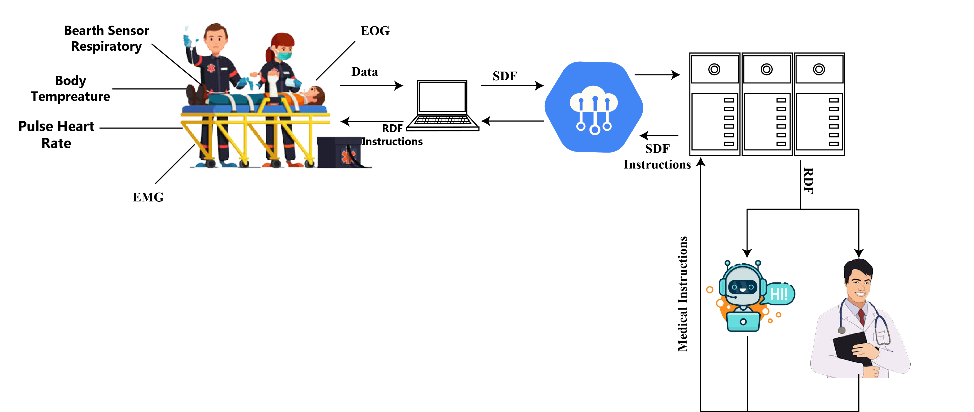
System Architecture

Slide 10
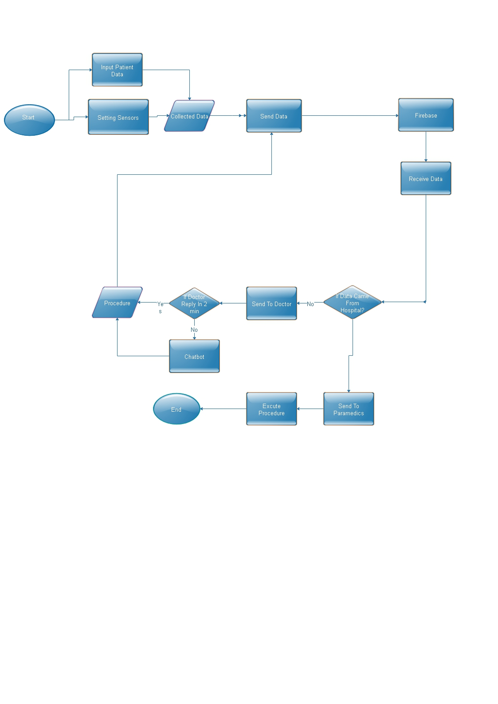
Flow Chart Diagram

Slide 11

Analysis
03

Slide 12
Related Work
1-Smart Road Accident Detection and Communication System
Authors in (2020) have developed a hardware system to detect car accidents with the help of sensors. The accident is detected by a vibration sensor and gyroscope sensor and immediately emergency contact numbers are notified with the GSM module. Also, the exact location is recognized by the GPS module.
2-Biomedical sensors with IOT
Authors(2021) present an IOT based health monitoring system using the My Signals development shield for Arduino Uno. Evaluating the performances and effectiveness of the sensors and wireless platform devices are also the aim of the project. My Signals enables multiple sensors such as temperature, ECG, oxygen saturation and pulse rate to gather the physical data.

Slide 13
Requirement Analysis
Req. ID | Req. Name | Req. Type | Description | Dependency Priority
 |  |  |  | BR | TR | Category
RE_01 | Sensor installation | Tec. | The paramedic places the sensors on the body of the injured person, as he puts each sensor in its correct place | - | - | Must
 |  |  |  |  |  | Funct.
RE_02 | Reading Sensor Data | Tec. | The sensors take vital readings from the patient's body | - | RE_01 | Must
 |  |  |  |  |  | Funct.
RE_05 | Sending Data | Tec. | After the application finishes the patient personal data, it sends the data from the ambulance to the firebase and vice versa | - | RE_04 | Must.
 |  |  |  |  |  | Funct.
RE_06 | Receiving Data | Tec. | The system server located in the hospital receives the data sent from the application to firebase and vice versa | - | RE_05 | Must
 |  |  |  |  |  | Func
RE_07 | Analysis data |  | The Doctor and Chatbot analysis data | - | RE_06,RE_07,RE_08 | Must
 |  |  |  |  |  | Func
RE_8 | Give medical instructions | Tec | After analyzing the data, the doctor gives medical instructions to the paramedic, and if he isn’t response , the chatbot takes over | - | RE_09 | Must
 |  |  |  |  |  | Func
RE_9 | Fast | Tec | The system must be very fast to ensure the survival of infected people | - | - | Must
 |  |  |  |  |  | Non-Func
RE_10 | security | Tec | The system must be well secured so that patient data is not vulnerable to hacking | - | - | Must
 |  |  |  |  |  | Non-Func

Slide 14

04
Tools

Slide 15
Techniques
1- Firebase
Firebase is a Backend-as-a-Service (Baas).
Firebase is an app development platform that helps you build and grow apps and games users love. Backed by Google and trusted by millions of businesses around the world.
Firebase is a new technology for managing large amounts random data. Very fast compared to RDBMS. This research paper focuses on usage of Firebase for Android and aims to familiarize itself with its functions, related concepts names, benefits and limitations.
The most important features of Firebase
Real-time Database − Firebase supports JSON data and all users connected to it receive live updates after every change.
Authentication − We can use anonymous, password or different social authentications.
Hosting − The applications can be deployed over secured connection to Firebase servers.

Slide 16
Techniques Cont.
2-Authentication: Firebase authentication makes it easy for developers to protect authentication systems and improves login and boarding experience for users. This the feature offers an all-in-one identity solution, supporting email accounts and password, phone auth, moreover like Google login, Facebook, GitHub, Twitter and more.
3- Chatbot Works
Chatbot is a JavaScript library designed to make it easy to create software that can engage in conversation.
An untrained instance of Chatbot starts with no knowledge of how to communicate. Each time a user enters a statement, the library saves the text that they entered and the text that the statement was in response to. As Chatbot receives, more input the number of responses that it can reply and the accuracy of each response in relation to the input statement increase.
The program selects the closest matching response by searching for the closest matching known statement that matches the input, it then chooses a response from the selection of known responses to that statement.

Slide 17
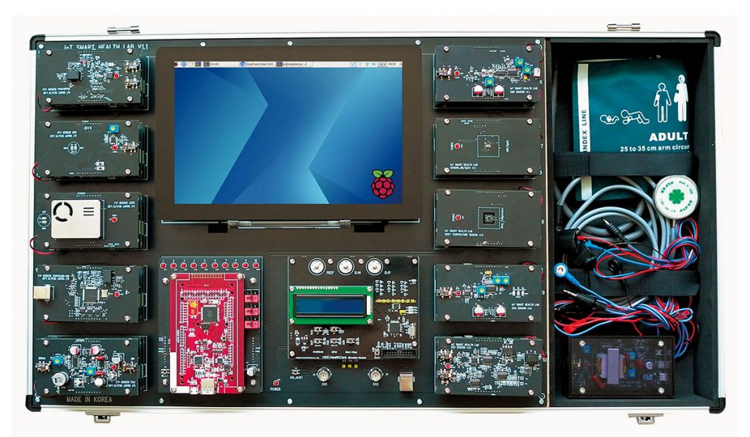
Tools
Smart IoT Health Lab
We use a smart IoT health Lab practice equipment with IoT technology. It is capable of analyzing up to 13 types (11 basic types) of biomedical signals and transmitting or receiving the data through Wi-Fi or Bluetooth. It also can be remotely monitored from PC and Smart Phone through Hybrid Web.

Slide 18
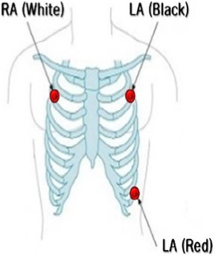
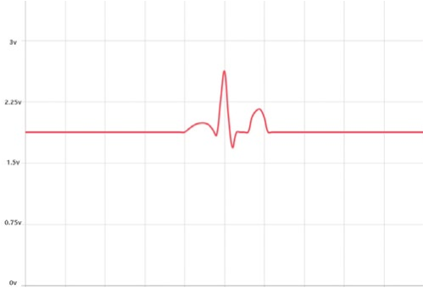
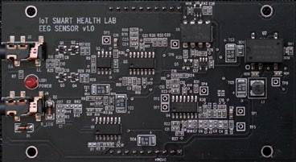
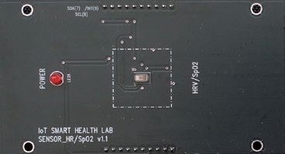
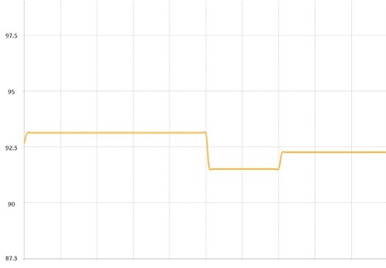
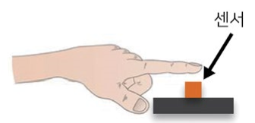
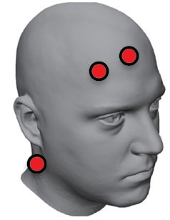
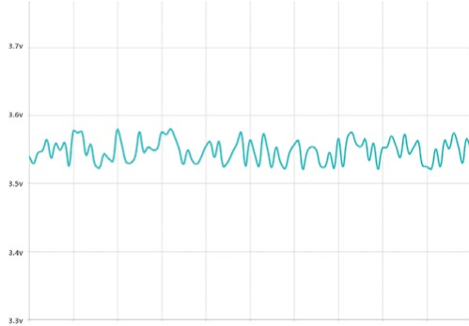
Tools Cont.
ECG (Electro CardioGram)
When the heart is beating, the minute action potential difference in the myocardium is measured by the electrode attached to the body surface, and the change curve over time is expressed in mV.
SpO2 (Pulse Oximeter)
The percentage of hemoglobin concentration that contains oxygen to the concentration of total hemoglobin in the blood stream is measured by optical method.
EEG (Electro EncephaloGram)
Using an electrode attached to the surface of the head, electrical signals from the brain’s electrical activity are measured non-invasively.
Used Module
Waveform (mV)
Location of Electrodes
Sensor
Measurement Method
Used Module
Waveform (%)
Used Module
Measurement Method
Waveform (Hz)

Slide 19
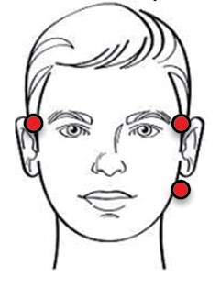
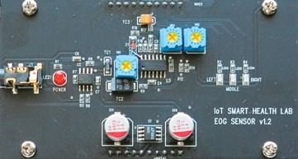
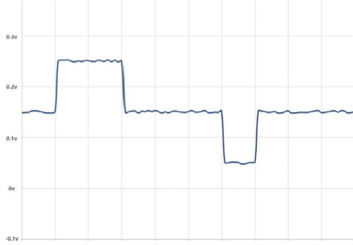
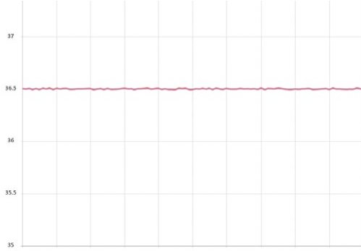

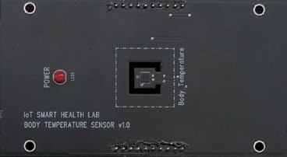
Tools Cont.
EOG (Electro OculoGraphy)
Measures minute voltage between retina and cornea caused by eye movement.
BT (Body Temperature)
Measures the temperature of the human body.
PCG Phono CardioGram
The condenser microphone is used to amplify the heart sound and the value is measured with its waveform and sound.
Measurement Method
Used Module
Waveform (V)
Sensr
Measurement Method
Used Module
Waveform (°C)

Slide 20
05
Implementation and results

Slide 21
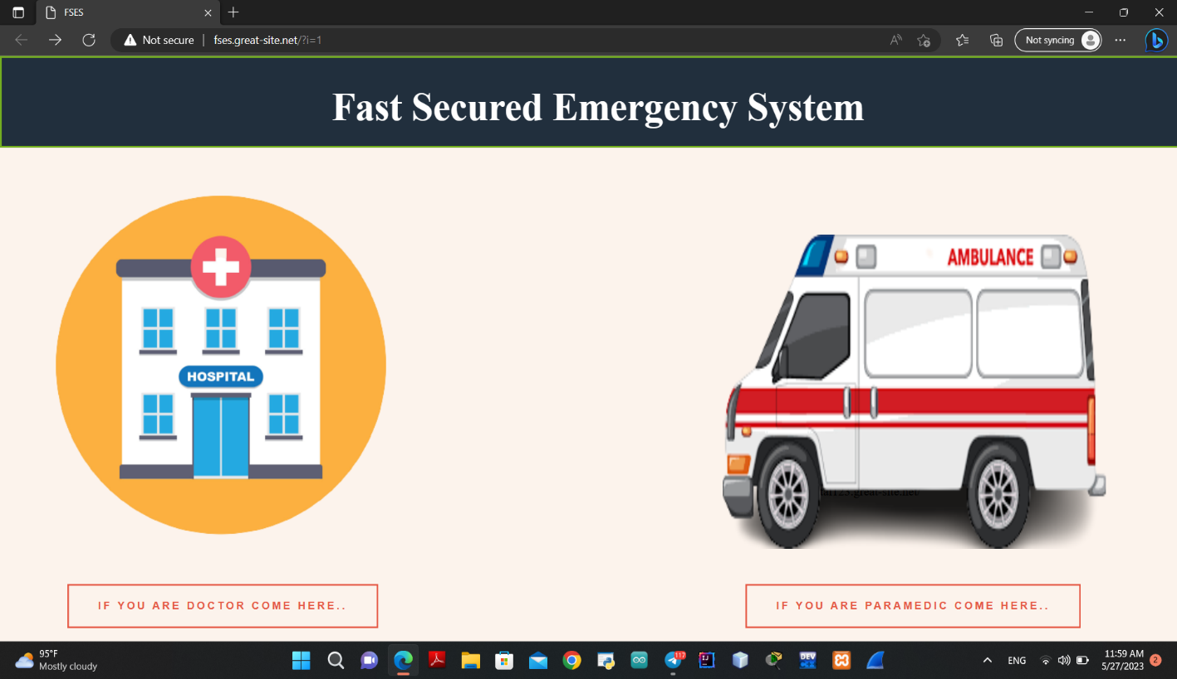
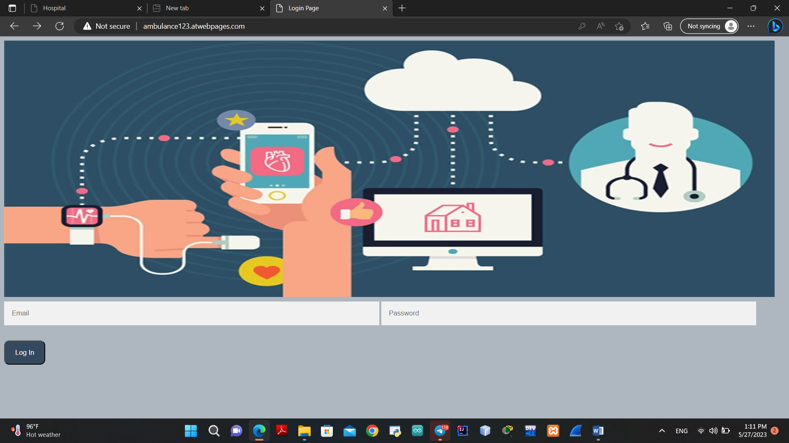
Home and login

Slide 22
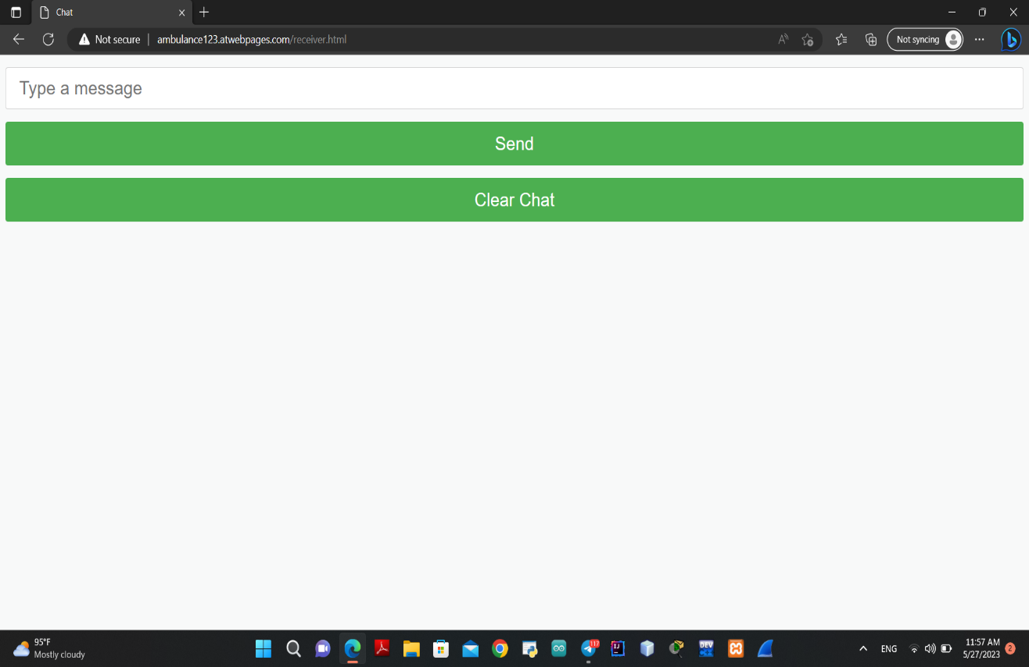
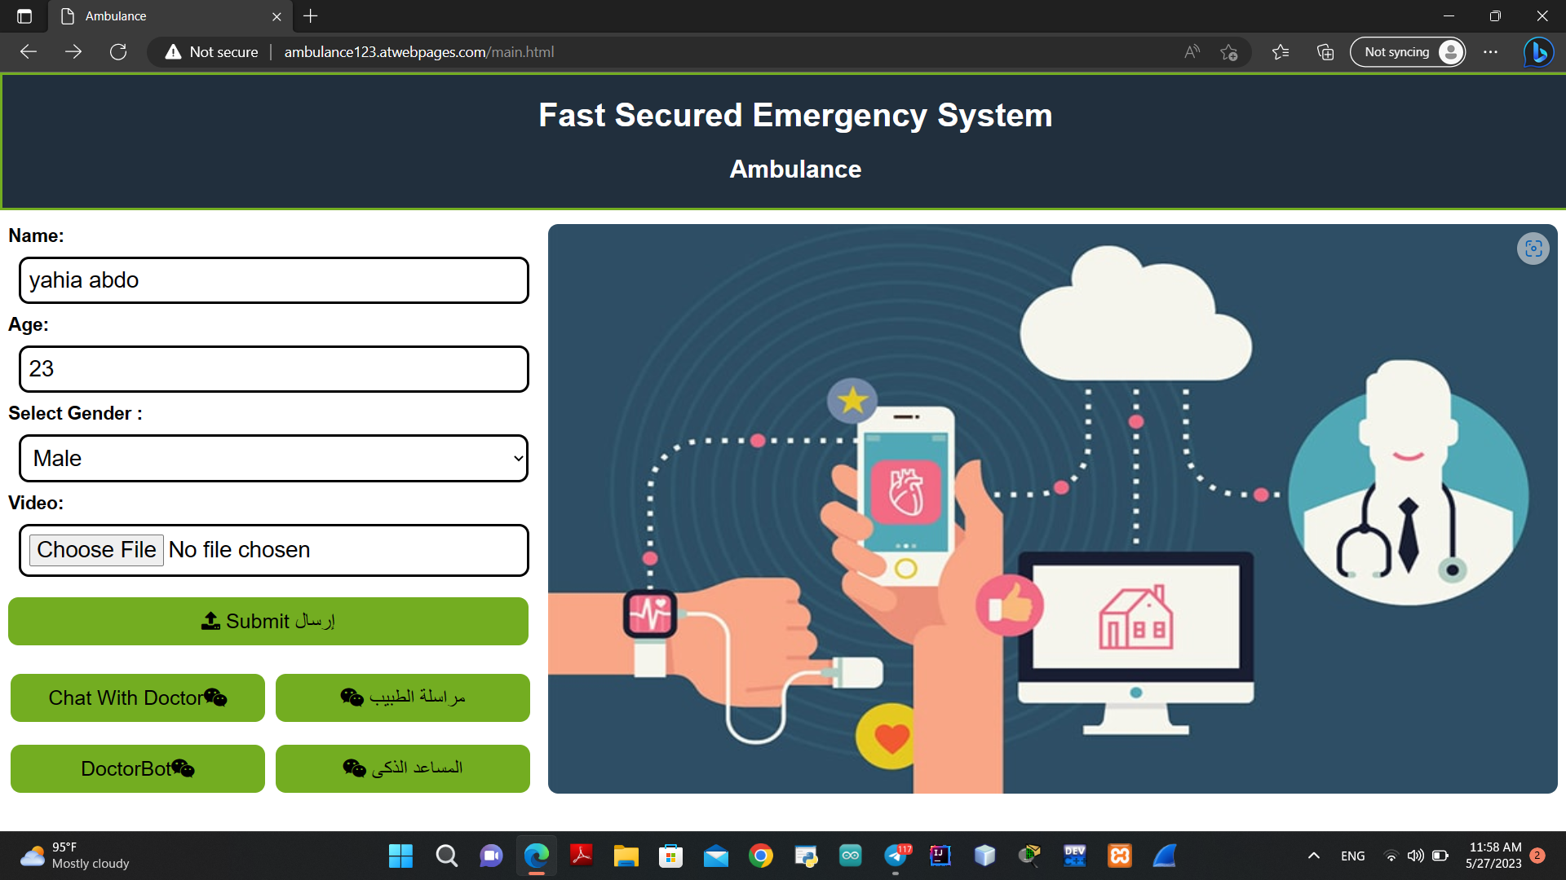
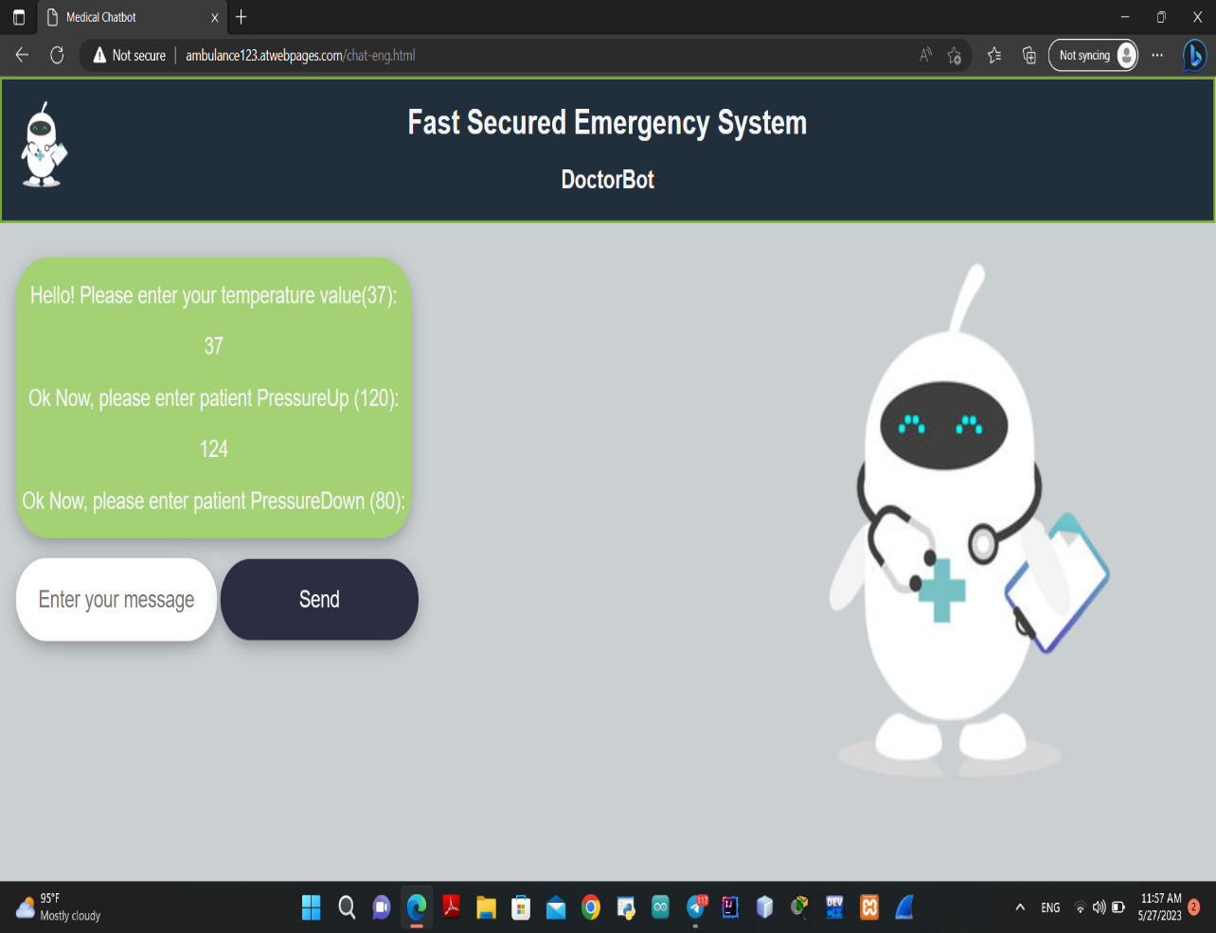
ambulance side
Chat with doctor
Patient Data
DoctorBot

Slide 23
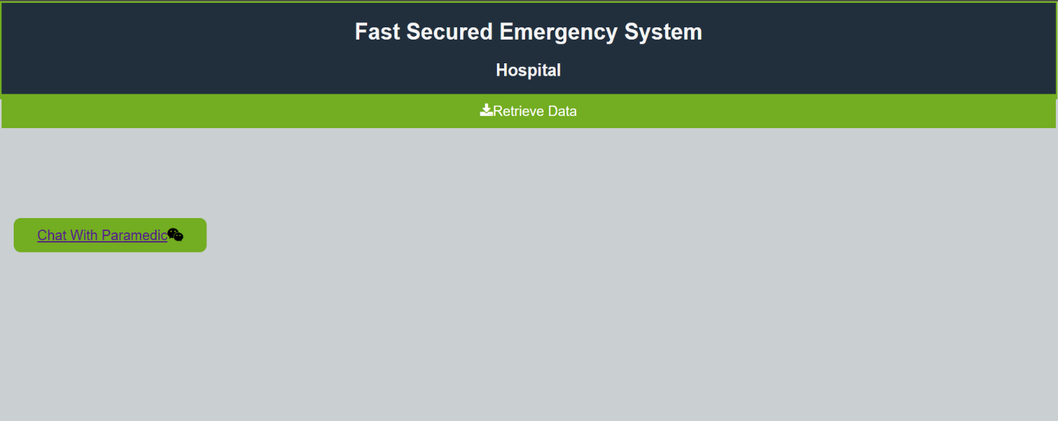
Hospital side

Slide 24
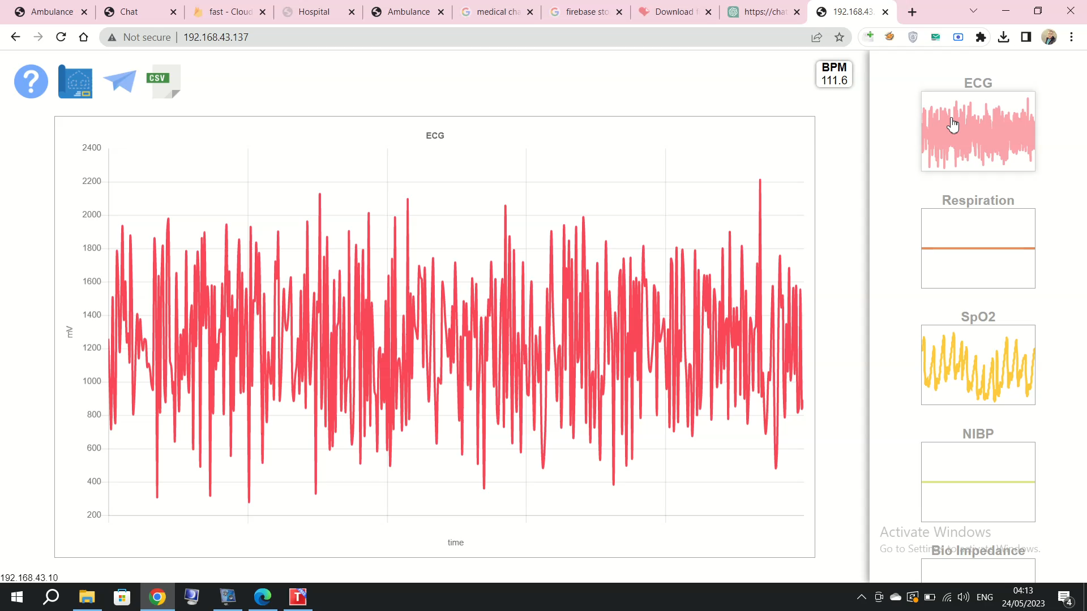
Results

Slide 25
Conclusion
In conclusion, our experimental results demonstrate that our IoT Smart Health Lab system is an effective solution for collecting and transmitting patient data in real-time. By providing doctors with quick access to this information, we can improve patient outcomes and reduce healthcare costs. Additionally, by incorporating a chatbot for paramedics, we can ensure that patients receive timely care even when their primary physician is unavailable.

Slide 26
Thanks

